Slide 1





KEYNOTE PRESENTATION
FORECASTING FROM STATIC IMAGES
Using Variational Autoencoders

Slide 2


THE PURPOSE-
WE WANT FROM A SINGLE IMAGE TO BE ABLE TO PREDICT THE MOTION OF THE PIXELS ONE SECOND LATER

Slide 3
BACKGROUND:
SIFT
OPTICAL FLOW

Slide 4
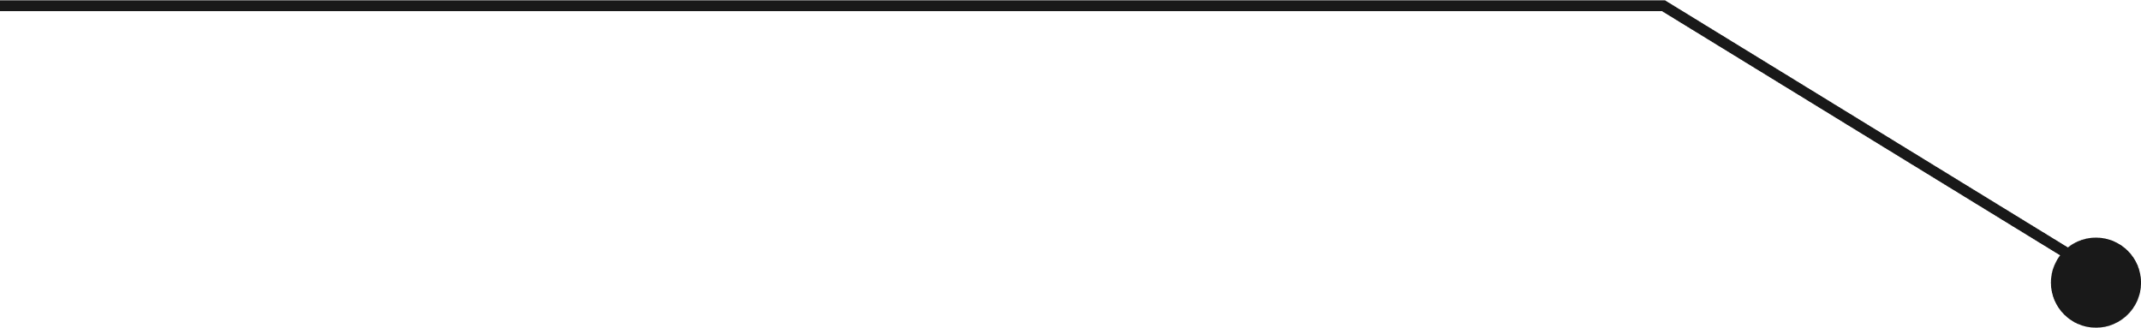
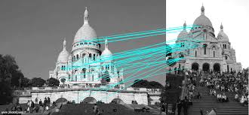

SIFT
SIFT (Scale-Invariant Feature Transform) is a technique for image matching that can identify and match features in images that are invariant to scaling, rotation, and affine distortion.

Slide 5
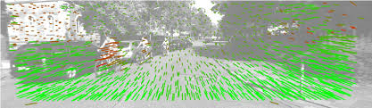
OPTICAL FLOW
Optical flow is a technique used to describe image motion. It is usually applied to a series of images that have a small time step between them, for example, video frames. Optical flow calculates a velocity for points within the images, and provides an estimation of where points could be in the next image sequence.

Slide 6




DISADVANTAGES:
1
SENSITIVE TO NOISE
Both of these methods are sensitive to noise because they work on detecting pixels between two images
2
WIDE INPUT
Both of these methods are based on an input of at least two images

Slide 7


ADVANTAGES
NEXT FRAME
ONE SECOND
we don't have the next frame In the test
our approach is able to predict for a relatively long period of time
FEW TRAJECTORIES
ONE IMAGE
tackle the possibility of multiple potential futures
our algorithm predicts from a single image

Slide 8
CHALLENGES:
THERE IS A HUGE AMOUNT OF POSSIBLE TRAJECTORIES, OF WHICH ONLY THE RELEVANT ONES SHOULD BE RETURNED
THERE IS MORE THAN ONE SUITABLE TRAJECTORY

Slide 9
ALGORITHM
INPUT- IMAGE
OUTPUT- THE POSSIBLE TRAJECTORY
(FOR EACH OF THE AXES)
FOR CERTAIN PIXELS

Slide 10
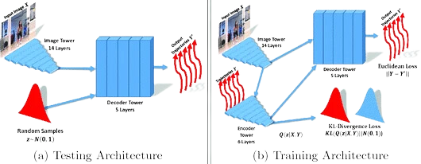
ARCHITECTURE
1. IMAGE TOWER
2. ENCODER TOWER
3. DECODER TOWER

Slide 11

image tower
Receives the 320×240 image as input,
returns a rendering of it

Slide 12
Encoder Tower
Ground-truth trajectories are the input and downsample them spatially such that they can be concatenated with the output of the image tower.
input consists of output from the image tower and trajectory data concatenated into one input data layer. returns the distribution Q

Slide 13
Decoder Tower
Receives as input a processed image and a distribution Q and processes them together to find trajectories

Slide 14
X - THE IMAGE
Y' - OUTPUT, FULL SET OF TRAJECTORIES
Y - TRUE TRAJECTORIES
Z - TRAJECTORY AND IMAGE COMPRESSING TO A LATENT SPACE
Q - DISTRIBUTION OF Y ON Z
N - THE NORMAL DISTRIBUTION

Slide 15
Train

Slide 16
PROBLEM-
An immediate objection one might raise is that this is essentially “cheating” at training time: the model sees the values that it is trying to predict, and may just copy them to the output.

Slide 17
SOLUTION-
To prevent the model from simply copying, we force the encoding to be lossy. The Q pathway does not produce a single z, but instead, produces a distribution over z values, which we sample from before decoding the trajectories.
The model is thereby encouraged to extract as much information as possible from the input image before relying on encoding the trajectories themselves.

Slide 18
Train

Slide 19
Test

Slide 20
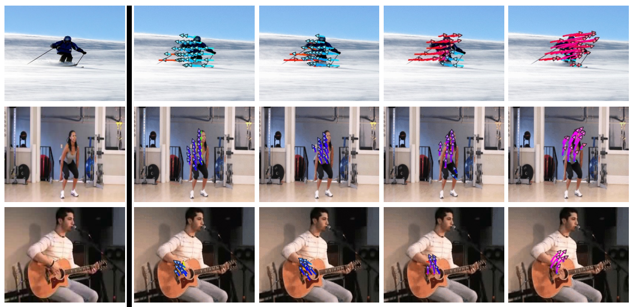
EXPERIMENTS

Slide 21
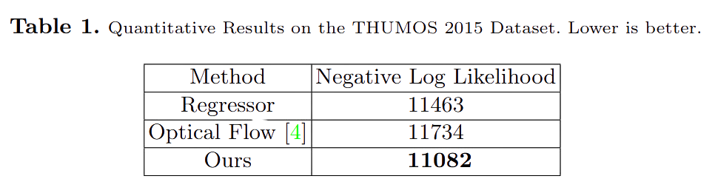
NLL - Negative log likelihood

Slide 22

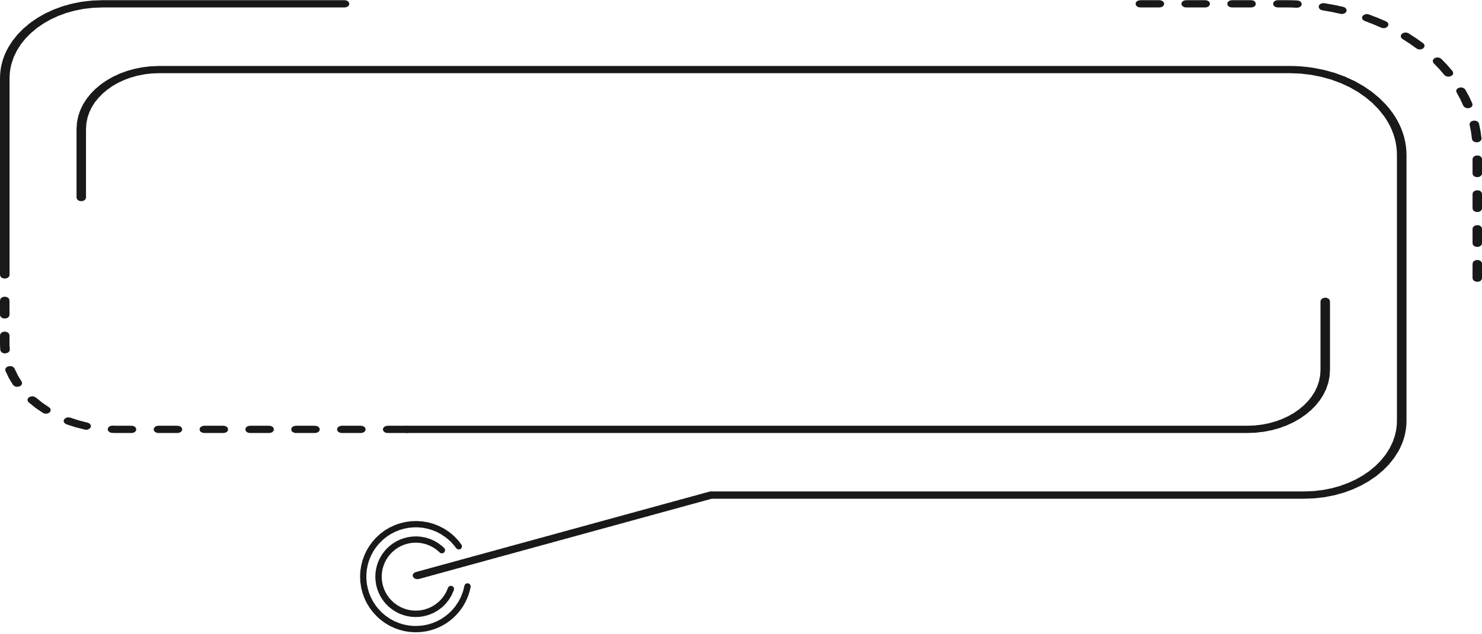

THANK YOU

